Slide 1



INTRO TO Deep Learning

Slide 2
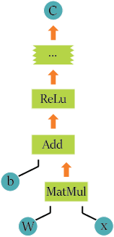
sTRUCTURE of tensorflow model
Data Flow graph Structure
Nodes are Mathematical Operations
Edges are multi-dimensional arrays (tensors)
Support For GPU and Distributed Computing

Slide 3
Deep Learning
Terminology:
Features
Labels
Training Set
Test Set
Validation Set
Model, Graph

Slide 4
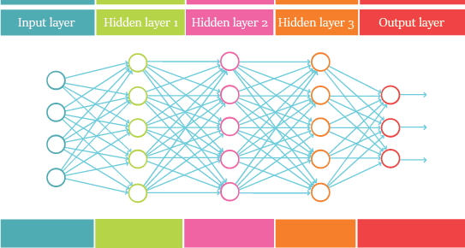
What is
Algorithms that attempt to model high-level abstractions in data by using multiple processing layers, with complex structures or otherwise, composed of multiple non-linear transformations.

Slide 5



Components of a simple Deep learning model
Linear Operation: Loss Function:
Optimizer Activation Function
Used to minimize the loss
Input function
$$y^{′}=b+ \sum{w_{i}x_{i}}$$
$$MSE= \frac{1}{N} \sum{{[y−y^{′}]}^{2}}$$
$$F\left(x\right)=max⁡(0,x)$$

Slide 6
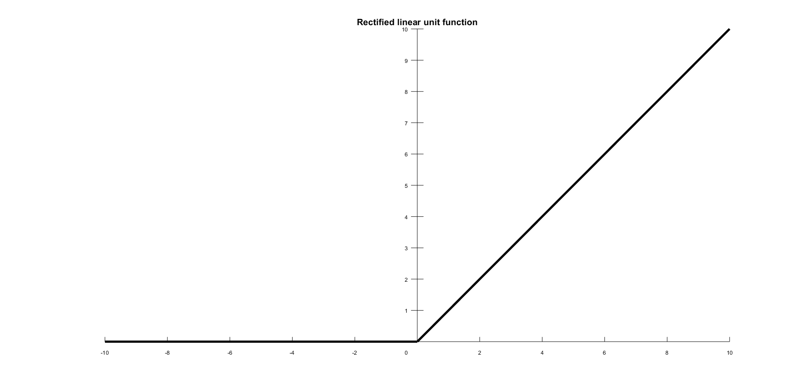
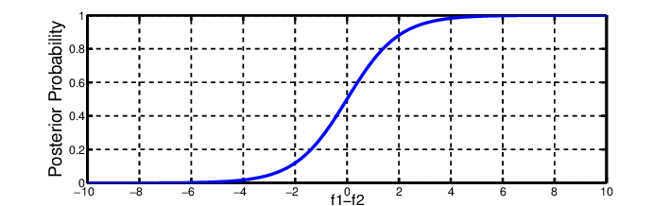
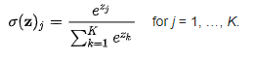

Activation Functions
Rectified Linear Unit
Softmax (Sigmoid Function)
$$F\left(x\right)=max⁡(0,x)$$

Slide 7
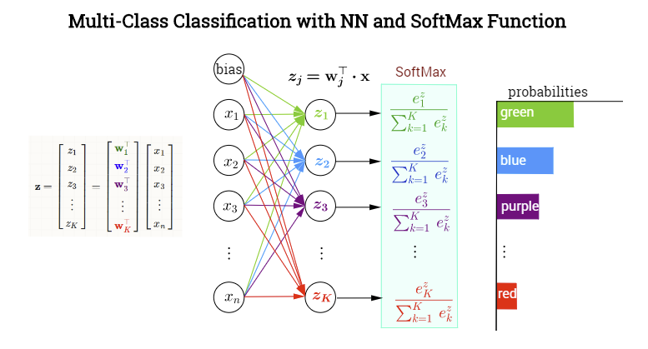
Softmax Model

Slide 8
Digit classification on MNISt dataset
55,000 data points
mnist.train.images for inputs
mnist.train.labels for outputs
Trainning
Validation
Test
5,000 data points
mnist.validation.images for inputs
mnist.validation.labels for outputs
10,000 data points
mnist.test.images for inputs
mnist.test.labels for outputs

Slide 9
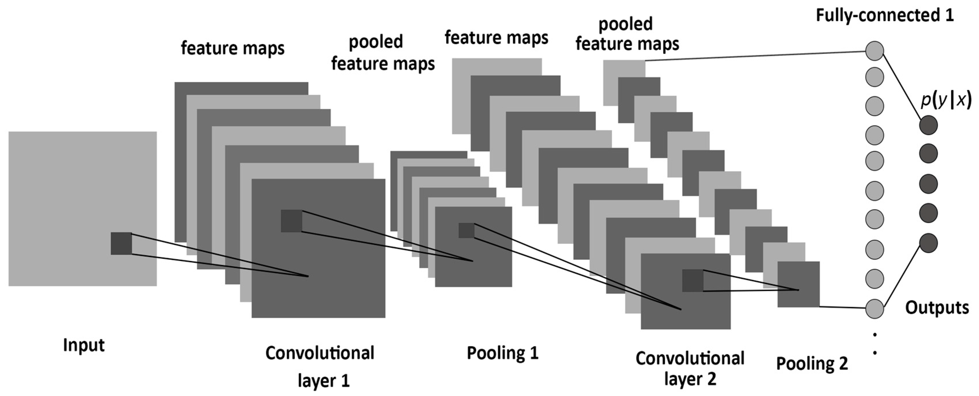
Types of Neural Networks
Neural Network Convolutional Neural Network

Slide 10
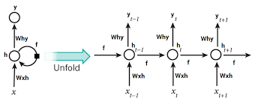
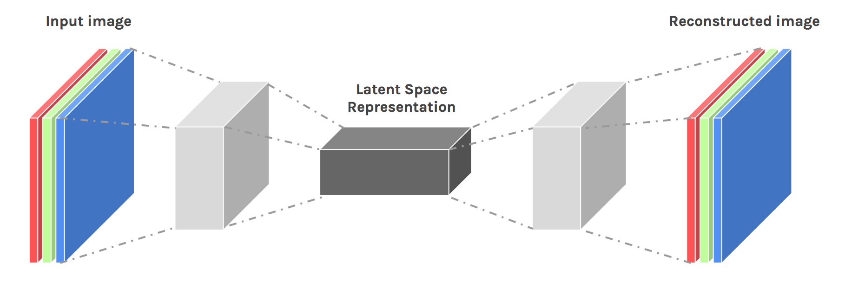
Types Of Neural Networks
Recurrent neural Network Autoencoders

